Slide 1

Data Science Development Tools
Part 1: Python, NumPy
Notes:
Prompt: image of miners mining diamonds in a diamond mine using pickaxes, with huge diamonds and a cart full of diamonds. Image from Gemini 2.5 Flash

Slide 2

Tools for Data Mining
Start with Pickaxe and Shovel
Move to jack hammer and other automated tools
Python, SQL, R most common languages
NumPy, Pandas, Matplotlib, Seaborn, Scikit-Learn
Tableau, PowerBI
AWS SageMaker, Dataiku, DataRobot, DataBricks

Slide 3
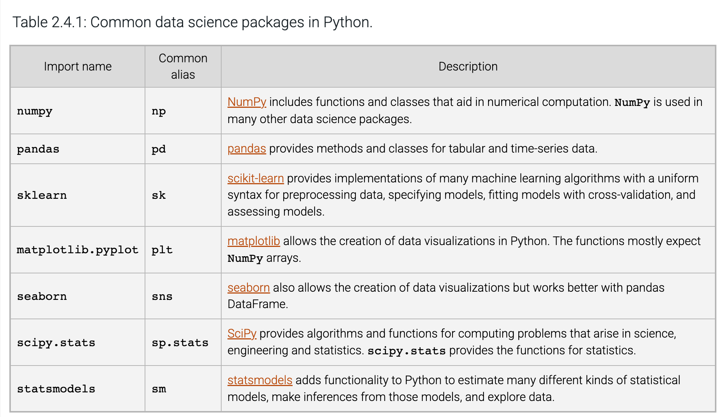
Common Data Science Packages for Python
CS 180

Slide 4
NumPy
Spelled: NumPy, Pronounced “num-pie”
What is NumPy? NumPy (Numerical Python) is the fundamental package for scientific computing with Python. It provides a high-performance multidimensional array object and tools for working with these arrays.
Why NumPy?
Speed: NumPy arrays are more efficient and faster than Python lists for numerical operations, as they are implemented in C.
Functionality: It provides a rich set of functions for linear algebra, Fourier transforms, and random number generation.
Foundation: Many other data science libraries like Pandas, SciPy, and Scikit-learn are built on top of NumPy.
Notes:
Resources: https://www.youtube.com/watch?v=9JUAPgtkKpI, https://www.youtube.com/watch?v=lLRBYKwP8GQ

Slide 5
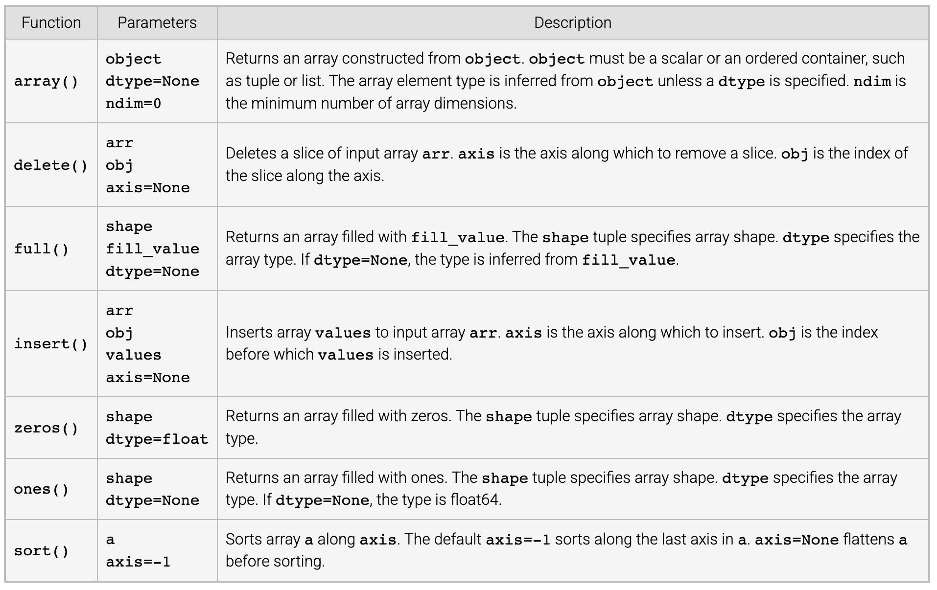
NumPy Array Functions

